Slide 1


DEPARTMENT OF COMPUTER SCIENCE AND ENGINEERING
20CS7503 & DESIGN PROJECT 3
END SEMESTER PRACTICAL EXAMINATION- NOV / DEC 2025
REVIEW PRESENTATION
Batch No:20
Date:28-11-2025
Session:AN

Slide 2
INTELLIGENT TRAVEL RECOMMENDATION SYSTEM FOR PERSONALIZED PLANNING AND BOOKING
Team Members:
S.MANESHAW (811722104086)
S.OVIYA (811722104106)
K.RAMISHA PARVEEN (811722104120)
Guide Name:
Mr. D.P.Devan M.E.

Slide 3
OBJECTIVE OF THE PROJECT
To develop an AI-powered travel recommendation system that suggests personalized itineraries based on user preferences, budget, and duration.
To integrate a booking module for seamless travel planning, covering flights, hotels, and activities.
To enhance user satisfaction by reducing the time and effort required for travel planning.

Slide 4
INTRODUCTION
In today’s fast-paced world, travelers face an overwhelming number of choices when planning trips.
Intelligent travel recommendation systems use AI and ML to analyze user preferences and historical data.
They offer personalized destination, accommodation, and activity suggestions. Our system goes a step further by integrating booking features into a single platform.
This approach ensures convenience, personalization, and efficiency.

Slide 5
LITERATURE SURVEY
TITLE | AUTHORS | PUBLISHER | TECHNOLOGY USED
An Intelligent Personalized Recommendation for Travel Group Planning Based on Reviews | Liu, X., Huang, Z., & Chen, L. | ResearchGate / IEEE (2017) | Natural Language Processing (NLP) for sentiment analysis, Collaborative Filtering (CF), and Content-Based Filtering.
Context-Aware Recommender Systems for Tourism | Gavalas, D., Kenteris, M., & Pantziou, G. | Springer (2014) | Context-aware computing, Mobile GIS, GPS-based location tracking, and Decision Support Systems.
Hybrid Recommendation Approach for Travel Planning | Ahmed, T., Rahman, M. S., & Kim, J. | Elsevier – Procedia Computer Science (2019) | Hybrid recommendation (Collaborative + Content-based), Machine Learning models (KNN, Matrix Factorization).

Slide 6
TITLE | AUTHOR | PUBLISHER | TECHNOLOGY USED
A Context-Aware Travel Recommendation System Based on Location and Weather | Li, H., & Lu, Y. | IEEE Access (2018) | GPS-based location tracking, Weather API integration, Context-aware recommender algorithms.
Tourism Recommendation System Based on Hybrid Filtering | Wang, J., & Li, X. | Elsevier – Expert Systems with Applications (2016) | Hybrid recommendation (User-based CF + Content-based), Data mining, Knowledge-based rules.
Personalized Travel Itinerary Generation Using Machine Learning | Sharma, P., & Gupta, A. | Springer – Advances in Intelligent Systems and Computing (2020) | Machine Learning (Decision Trees, Clustering), Collaborative Filtering, Google Maps API.
Using Social Media Data for Destination Recommendations | Chen, M., & Zhang, L. | ACM SIGKDD (2019) | Social media data mining, Sentiment analysis using NLP, Big Data processing with Spark.

Slide 7
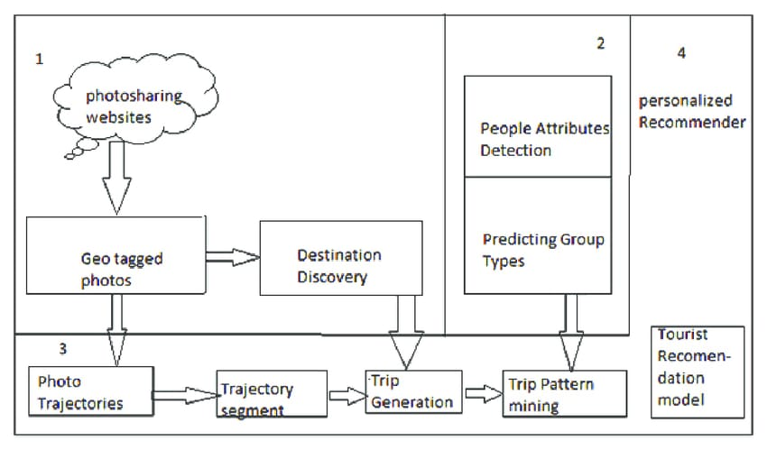
EXISTING SYSTEM

Slide 8
PROBLEM IDENTIFICATION
Too many travel options – People get confused because there are too many places, hotels, and packages to choose from.
No personalized suggestions – Most websites don’t give suggestions that match a person’s likes, budget, or travel style.
Takes too much time to plan – Travelers need to visit many different sites for booking flights, hotels, and activities.
Bookings are not connected – There is no single system to handle all bookings together in one place.
No real-time help – Users don’t get quick support or updates when travel plans change or when they need instant guidance.

Slide 9







PROPOSED SYSTEM
User
Chatbot
Booking
Server
Database
Payment

Slide 10
SOFTWARE AND HARDWARE REQUIREMENTS
HARDWARE
1. Processor: Intel i5 or higher
2. RAM: 8GB
3. MinimumStorage: 500GB HDD /
256GB SSD
SOFTWARE
1. Operating System – Windows 10 or higher
2. Front-End Technologies – HTML, CSS, JavaScript
3. Back-End Technology – PHP
4. Database – MySQL
5. Server – Apache Server

Slide 11
MODULES
1. User Profile Management – stores preferences, travel history.
2. Destination Recommendation – suggests destinations based on AI models.
3. Itinerary Planning – creates a daily travel schedule.
4. Booking System – integrates hotel, flight, and activity bookings.
5. Real-time Updates – adjusts recommendations based on live data.

Slide 12
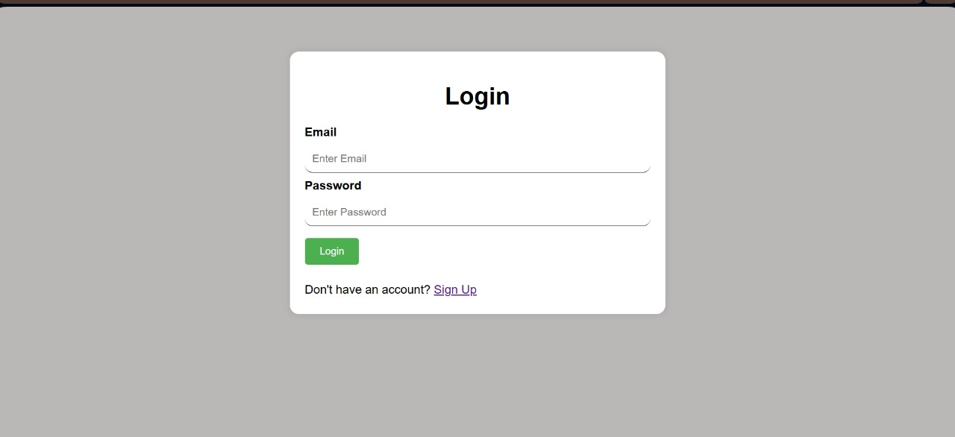
IMPLEMENTATION OF MODULE-1
1. Implemented secure user registration and login using PHP and MySQL to manage user authentication.
2. Stored and updated user preferences such as interests, budget, and travel history to support personalized outputs.
Login page

Slide 13
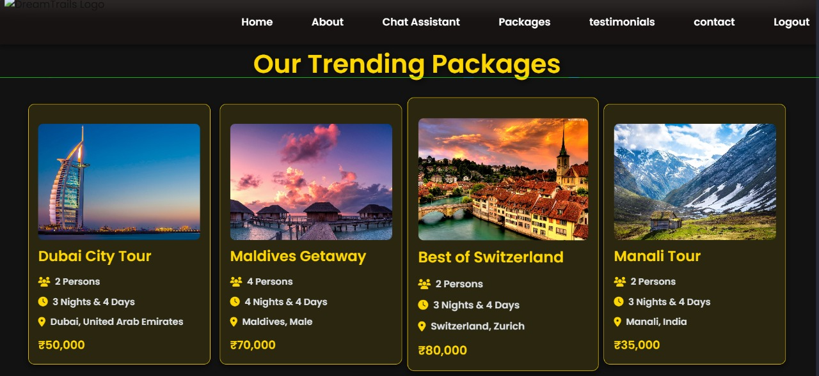
IMPLEMENTATION MODULE-2
1. Integrated an AI-based recommendation logic that matches user preferences with stored destination data.
2. Displayed personalized destination suggestions along with images, ratings, and key travel details.
Recommending Packages

Slide 14
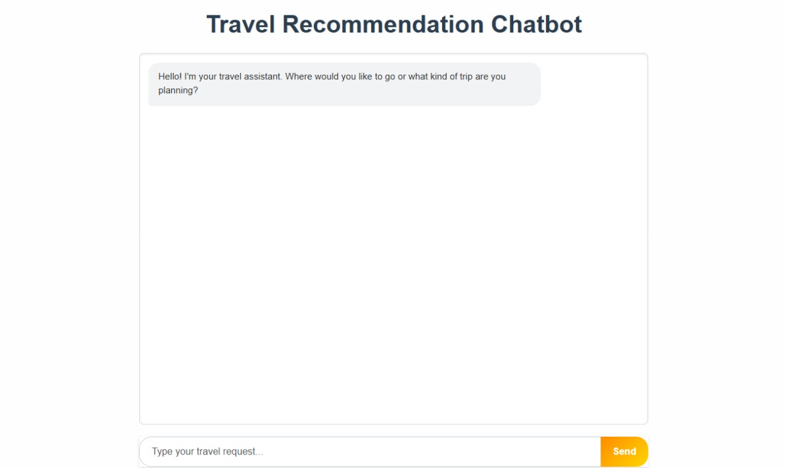
IMPLEMENTATION OF MODULE-3
1. Developed a chatbot interface that responds to user queries regarding destinations, bookings, and itinerary information.
2. Integrated simple rule-based or API-driven responses to provide instant assistance and improve user interaction.
Chatbot

Slide 15
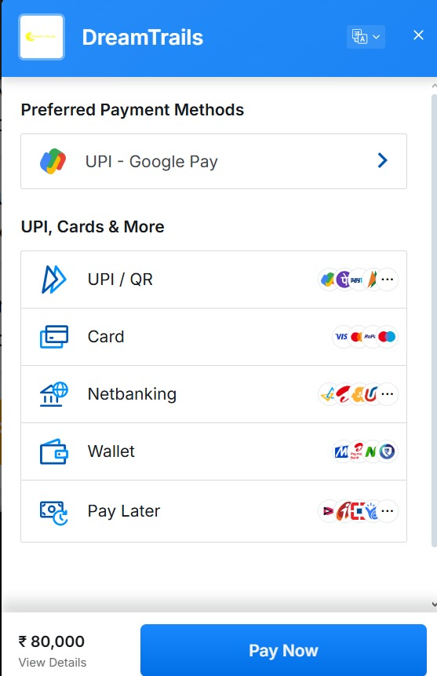
IMPLEMENTATION OF MODULE-4
1.Implemented booking forms for hotels, flights, and activities using PHP and MySQL to capture user booking details.
2. Added secure payment flow and stored booking confirmations, allowing users to track their reservations.
Payment

Slide 16
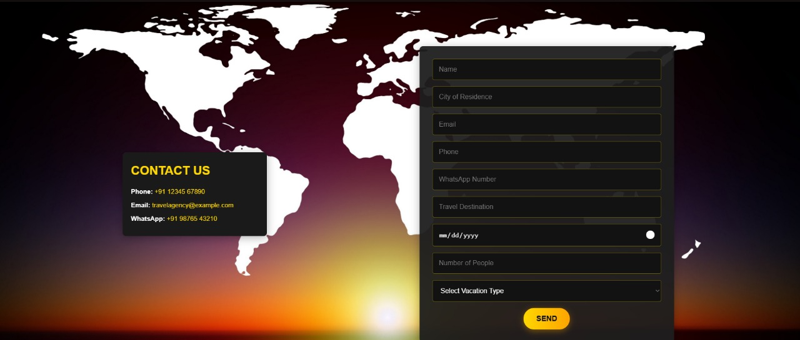
IMPLEMENTATION OF MODULE-5
1. Integrated real-time information such as weather updates, travel alerts, and price changes using external APIs.
2. Enabled dynamic updates on the UI so users can adjust travel plans based on live data.
Admin Page

Slide 17
CONCLUSION
The Dream Trails platform successfully provides a personalized and seamless travel planning experience by integrating AI-powered recommendations, secure bookings, and an intuitive user interface.
With its user-friendly design, real-time assistance, and scalable architecture, the project enhances customer satisfaction and simplifies the entire travel booking process

Slide 18
FUTURE ENHANCEMENTS
Add voice-based assistant – Include a voice chatbot to help users search and book trips using voice commands.
Use real-time weather updates – Show live weather information for destinations to help users plan better.
Multi-language support – Provide the system in different languages so people from various regions can use it easily.
Mobile app version – Develop a mobile app version for easier access and travel planning on the go.
18

